Slide 1
Extracting Evidence Fragments for Distant Supervision of Molecular Interactions
Gully A. Burns¹, Pradeep Dasigi², Eduard H. Hovy²
¹ Intelligent Systems Division, USC’s Information Sciences Institute
² Language Technologies Institute - Carnegie Mellon University

Slide 2
Studying A Complex Molecular Interaction Innocenti et al. 2002 pmid: 11777939
“Thus, under physiological conditions, the coimmunoprecipitation of Eps8 and Sos-1 depends on the integrity of the Eps8–E3b1 interaction, pointing to the existence of a physiological S/E/E8 complex.”

Slide 3
Distant Supervision based on Subfigure Annotations

Slide 4

https://www.ebi.ac.uk/intact/
European Bioinformatics Institute @ Cambridge, England
A large-scale, high-quality manually curated database
Basic Data Structure:
[PMID, Subfig, Protein1, Protein2, Protein3, Methods]
Content
~14K curated papers in total
~1K open access
6320 molecular interactions from 899 papers with sub-figure references

Slide 5
Mid-Level Discourse Structure in Results Sections
Context
Expt 1A
Expt 1B
Expt 1C
Interpretation
Innocenti et al. 2002 (PMID:11777939)

Slide 6
Discourse Types

Slide 7
Low Level Discourse Structure in Experimental Text
Innocenti et al. 2002 (PMC2173577)

Slide 8
SciDT – Scientific Discourse Tagger
SciDT uses deep learning (Dasigi, et al. 2017. arXiv:1702.05398).
Input data is a list of sub-sentence clauses in a given paragraph. (1) Use word2vec embeddings from Wikipedia + all PubMed abstracts + all PMC open access (Pysalo et al. 2013) to obtain D, this is converted via ‘Summarization’ to D_{summ},, which is then passed to a LSTM-RNN for labeling.

Slide 9
Discourse Tagging Performance
Accuracies and F-scores from 5-fold cross validation of SciDT in various settings and a Conditional Random Field model baseline (Burns et al. 2016, Database).
Dasigi, et al. 2017. arXiv:1702.05398

Slide 10
Heuristics for Identifying Evidence Fragments
For each subfigure mention in text (e.g., ‘Fig. 1 A’) scan backwards for any of 3 conditions between consecutive sentences S1 and S2 to indicate that S2 is the first sentence of the evidence fragment:
S1 contains (a) clauses that are tagged as ‘hypotheses’, ‘problems’, or ‘facts’ or (b) clauses that are tagged as ‘results’ or ‘implications’ that also contain external citations. S2 contains (a) clauses that are goals or methods or (b) results/implications with no external citations.
Both S1 and S2 contain references to subfigures that are entirely disjoint
S2 is a section heading
… and scan forward for similar conditions to indicate that S1 is the last sentence of the evidence fragment.

Slide 11
Delineating Experiments Across Results Sections
Innocenti et al. (2002)
Small-scale manual evaluation of 5 papers
(695 clauses, 133 figure references)
Checking if each clause was correctly labeled for Subfigures
Precision=0.53, Recall=0.94
F-Score=0.74.

Slide 12
The INTACT Evidence Fragment Corpus
doi:10.6084/m9.figshare.5007992.v5
Data set defined as a Research Object
INTACT data expressed as BioPax
National Library of Medicine’s ‘BioC’ format
http://bioc.sourceforge.org
BioC Linked Data: http://purl.org/bioc
Lightweight + Flexible
Document / Passage / Annotation / Location
~20K Evidence Fragments
Supplemented with SPAR + Dublin Core + PROV ontologies

Slide 13
Event Extraction with REACH System ‘Out-of-the-box’
https://github.com/clulab/reach
A biomedical event extraction system
Developed by Mihai Surdeanu’s group at University of Arizona
http://clulab.org/
Applies an extensive library of extraction patterns to detect binding, phosphorylation, activation.
Not designed (yet) to examine molecular interaction evidence
Baseline performance:
43.5% correctly identifies a ‘Complex Assembly’ event
5.6% perfectly reconstructs INTACT record

Slide 14
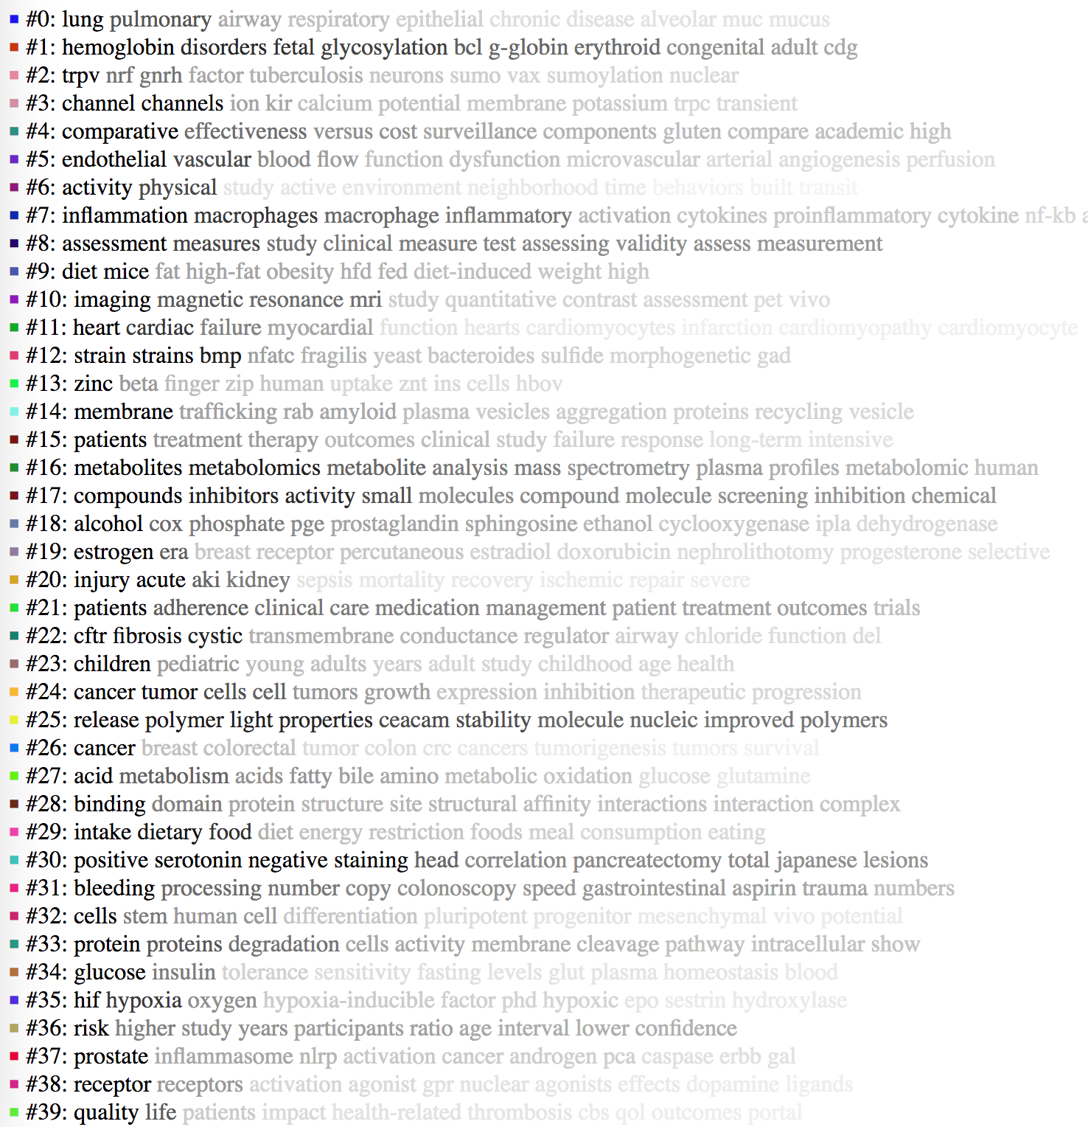
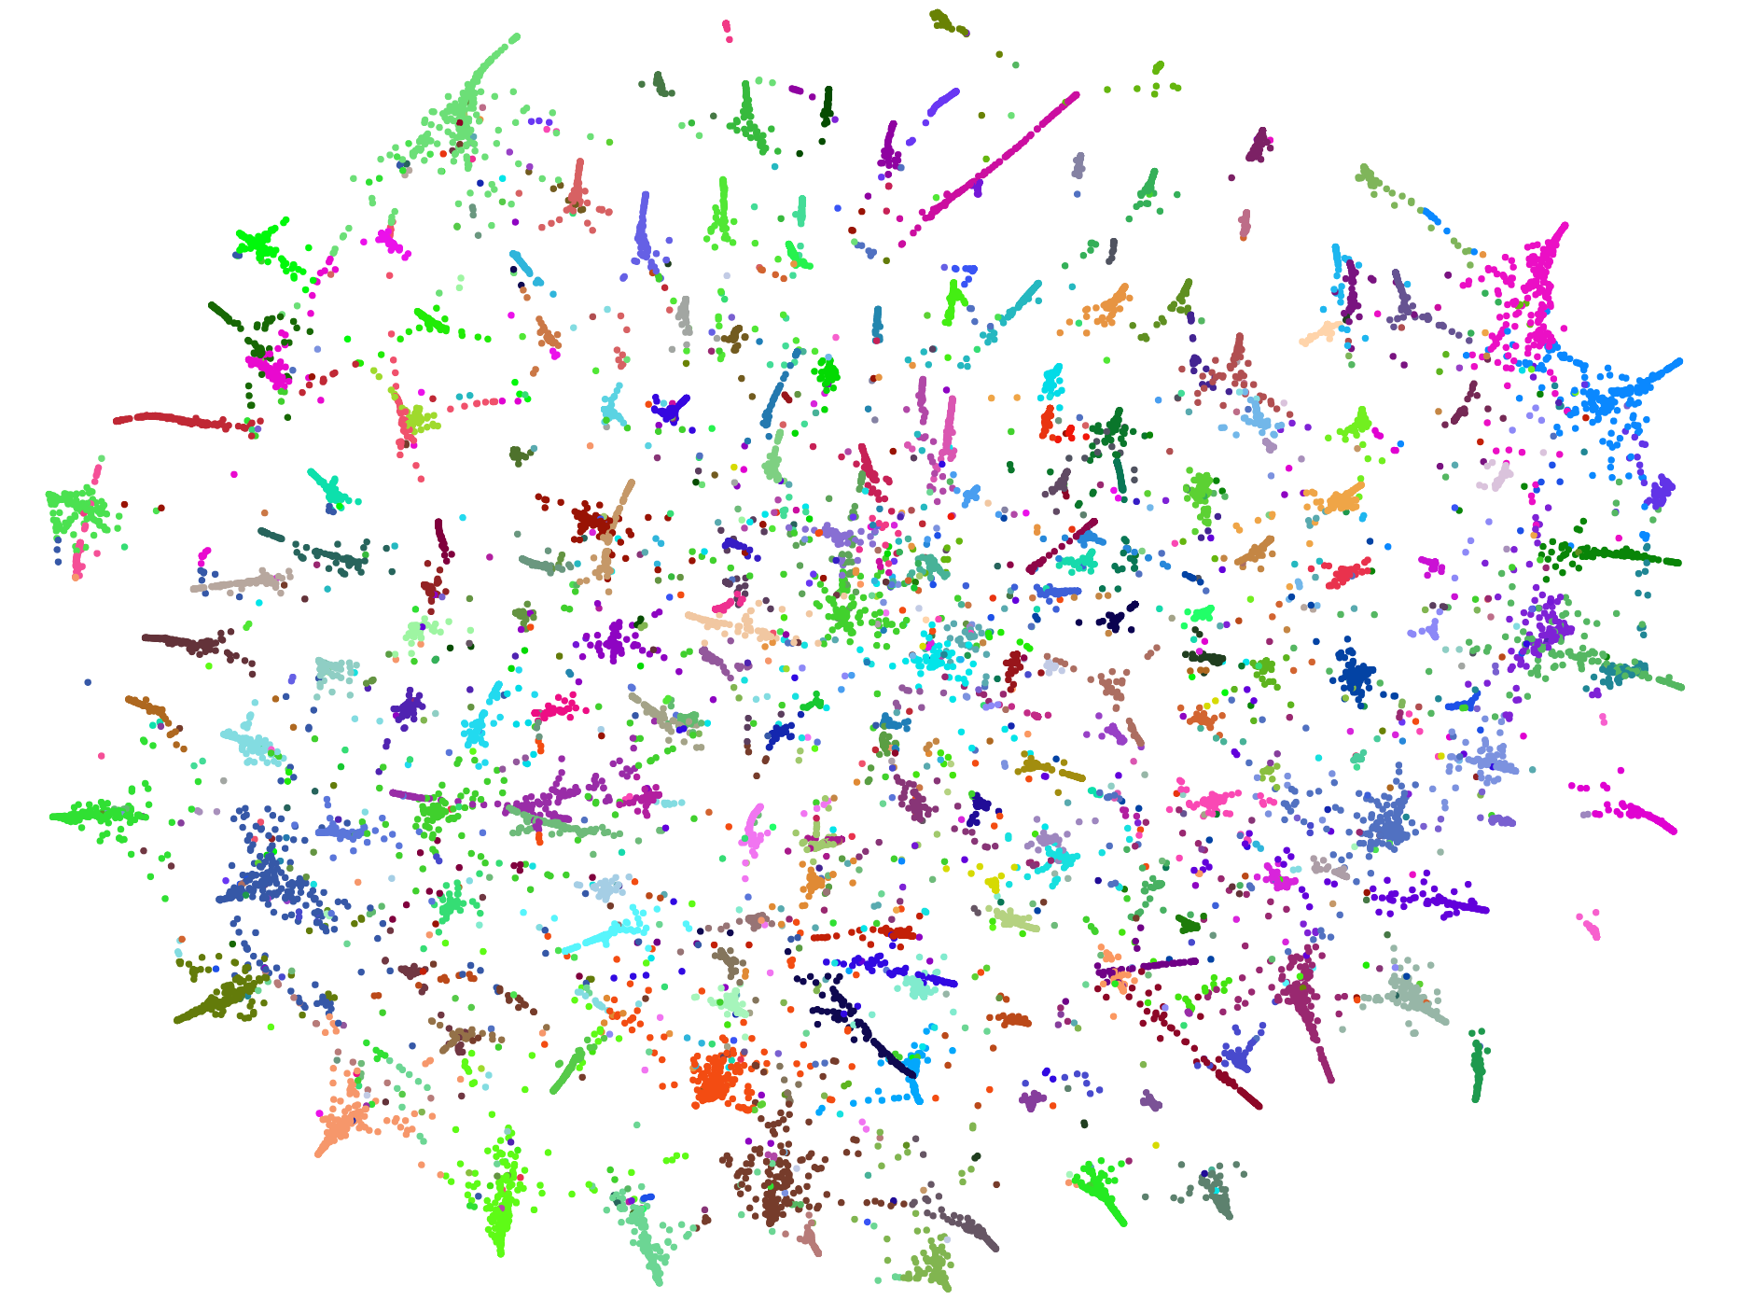

Slide 15
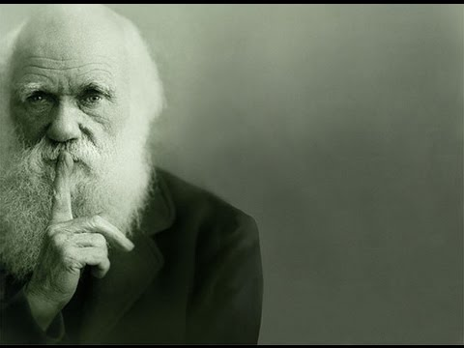
Acknowledgements
Anita de Waard
Hans Chalupsky
Sandra Orchard
DARPA Big Mechanism
under ARO contract
W911NF-14-1-0436
‘EvidX’ project (NLM)
R01LM012592-01

